Slide 1
Student Survey

Slide 2
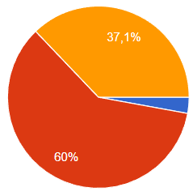
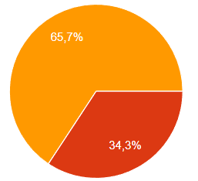
Connection between income statement and balance sheet
BEFORE THE GAME
AFTER THE WEEK

Slide 3
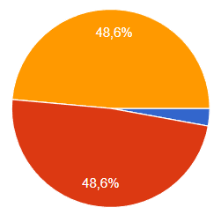
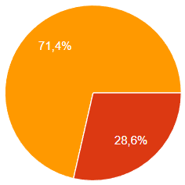
My language skills for international business
BEFORE THE GAME
AFTER THE WEEK

Slide 4
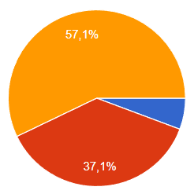
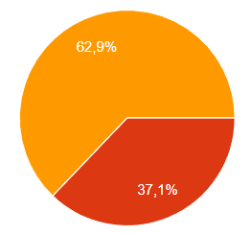
Use the 4ps of the marketingmix
BEFORE THE GAME
AFTER THE WEEK

Slide 5
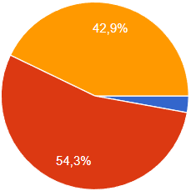
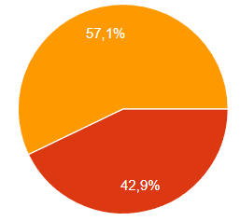
Logistics process of a company
BEFORE THE GAME
AFTER THE WEEK

Slide 6
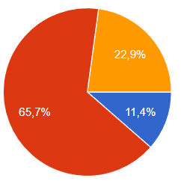
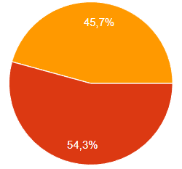
HR related processes in the business
BEFORE THE GAME
AFTER THE WEEK

Slide 7
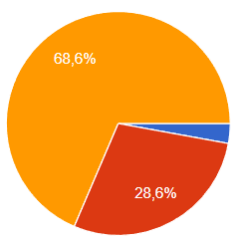
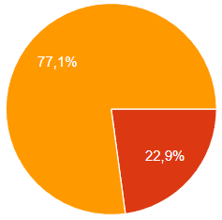
Do teamwork effectively and keep cooperative team spirit
BEFORE THE GAME
AFTER THE WEEK

Slide 8
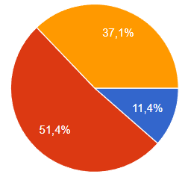
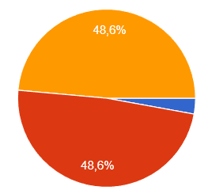
Macro economical basics: GDP, inflation, interest, employment
BEFORE THE GAME
AFTER THE WEEK

Slide 9
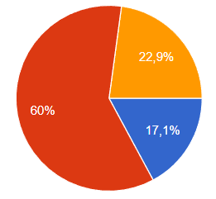
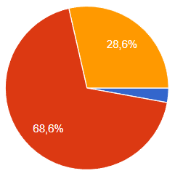
Identify and understand PESTLE trends
BEFORE THE GAME
AFTER THE WEEK

Slide 10
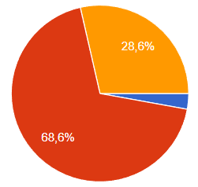
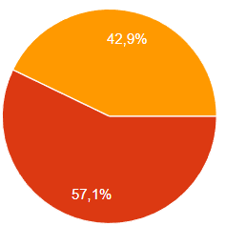
Variable and fixed costs, loan and interest calculations, depreciations
BEFORE THE GAME
AFTER THE WEEK

Slide 11
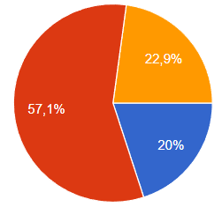
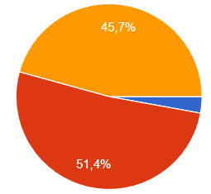
Calculate gross margin and/or break even
BEFORE THE GAME
AFTER THE WEEK

Slide 12
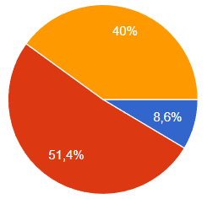
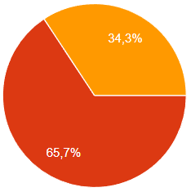
Do pricing related calculations
BEFORE THE GAME
AFTER THE WEEK

Slide 13
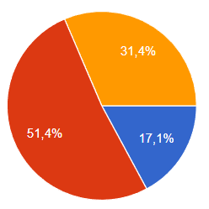
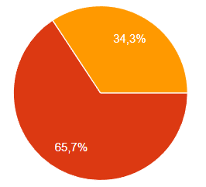
Make cash flow calculation for a company
BEFORE THE GAME
AFTER THE WEEK

Slide 14
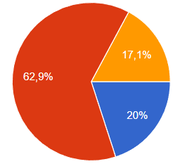
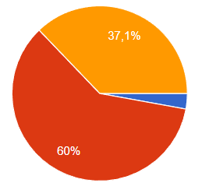
Understanding and interpreting financial ratios
BEFORE THE GAME
AFTER THE WEEK

Slide 15
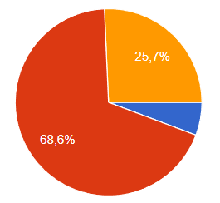
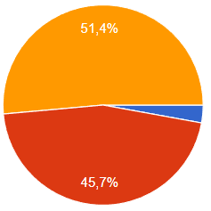
How to make decisions based on the financial data
BEFORE THE GAME
AFTER THE WEEK

Slide 16
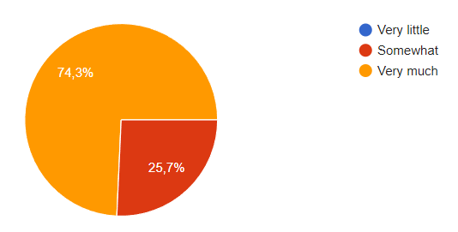
I enjoyed playing the game
“I've played the game before back at Summa, I didn't like it too much then. However, this school setting combined with the international groups/ students made the experience much more exciting. Which therefore improved my motivation to play the game, I ended up understanding it well, which the whole more fun.”

Slide 17
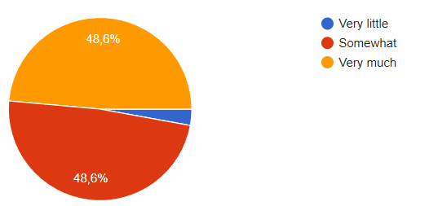
I learnt about school subjects (theory into practice)
“The game is a great way of putting into practice what you've learnt and gaining a better understanding of the internal world of the company.”

Slide 18
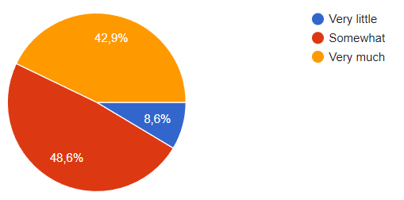
My language skills improved.
“Talking English all day improves my skills a lot.”

Slide 19
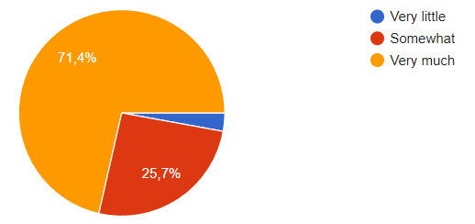
I experienced good teamwork.
“I learned to find a common language in a team. At first it didn’t seem easy, but then we succeeded.”

Slide 20
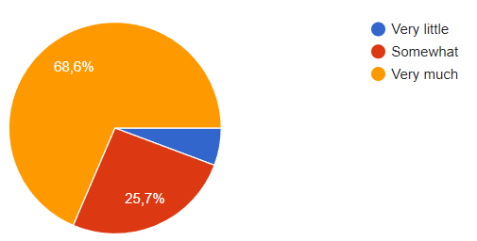
I experienced International cooperation
“We are from six different nationalities, six different cultures and six different perspectives. So we have a lot of different opinions and understanding of business. It was great learning, working and socializing with both student and teachers.”

Slide 21
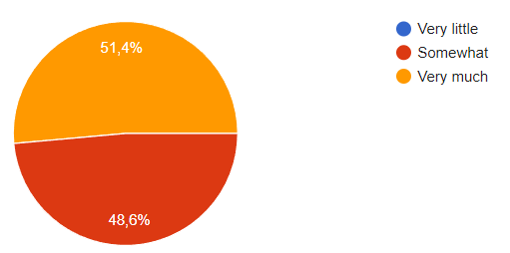
I learnt about my own managing skills.
“I chose Product manager because I never had experience in this field and now I have gained this experience.”

